Slide 1
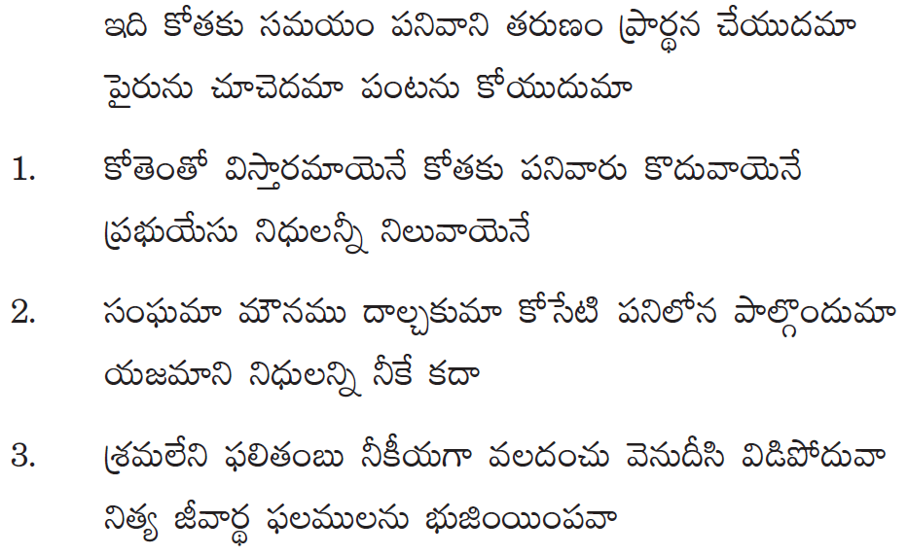
TELUGU CHRISTIAN FELLOWSHIP of MN
Notes:
TCFMN

